Slide 1

DNA computing simulations +
Adleman experiment
AYDIN WELLS
CSE40/60932 – Exotic Computing
13/19/2024

Slide 2

Code and Github
Python module (set of functions)
Modular for custom inputs
Image generation
Tested on Python 3.12 (as of 12/19/2024)
Scan for code!
https://github.com/Aywells/Exotic-Computing-Project

Slide 3
DNA computing basic operations
Strand generation, base paring, alignment

Slide 4


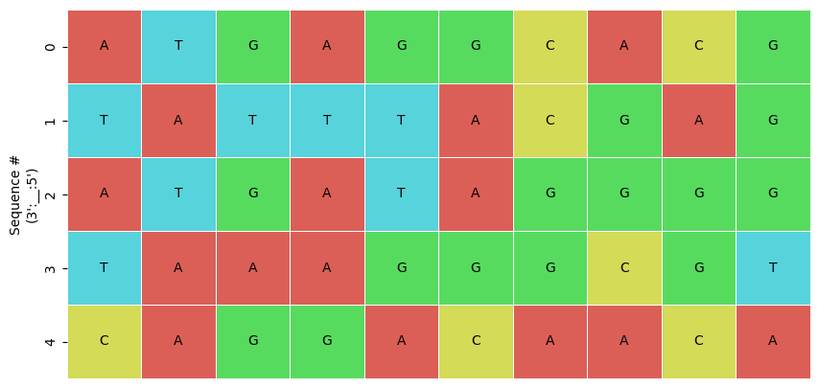
Operations
Generate a random strand(s) or load in existing FASTA file

Slide 5
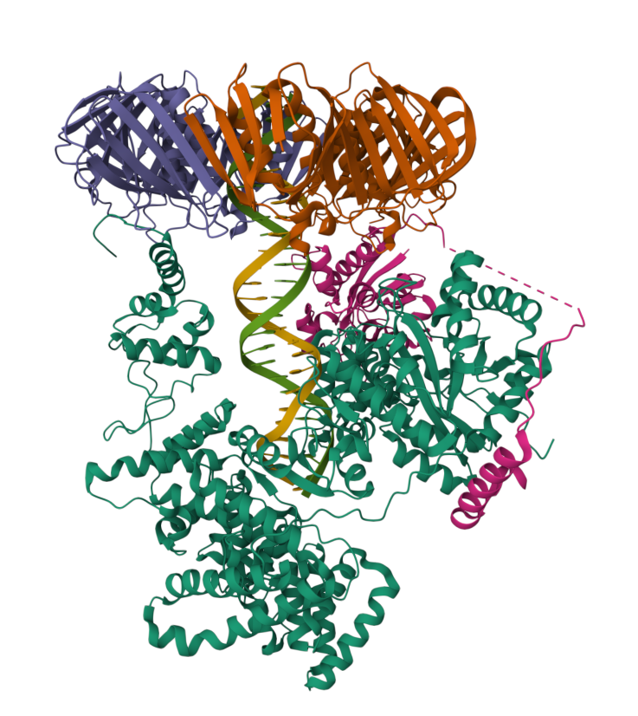
Operations
Generate a random strand(s) or load in existing FASTA file

Slide 6

Operations
Generate a random strand(s) or load in existing FASTA file
Generate a complement to a strand

Slide 7
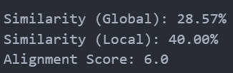
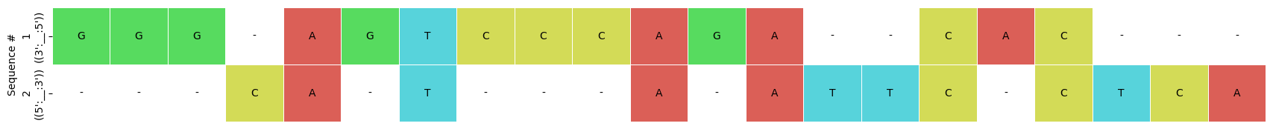
Operations
Generate a random strand(s) or load in existing FASTA file
Generate a complement to a strand
Align two strands (i.e., BLAST variation)

Slide 8

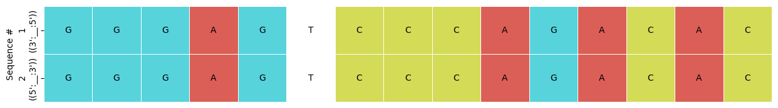
Operations
Generate a random strand(s) or load in existing FASTA file
Generate a complement to a strand
Align two strands (i.e., BLAST variation)

Slide 9
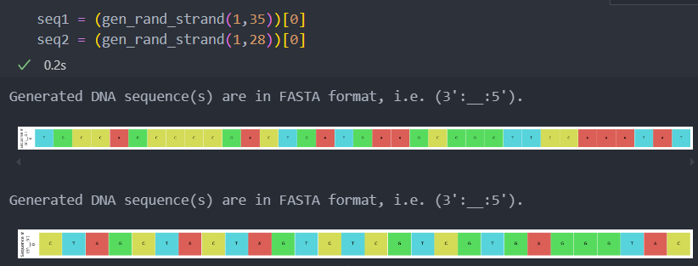
Operations
Generate a random strand(s) or load in existing FASTA file
Generate a complement to a strand
Align two strands (i.e., BLAST variation)
Renature two strands

Slide 10
Adleman experiment
Simulation with example

Slide 11
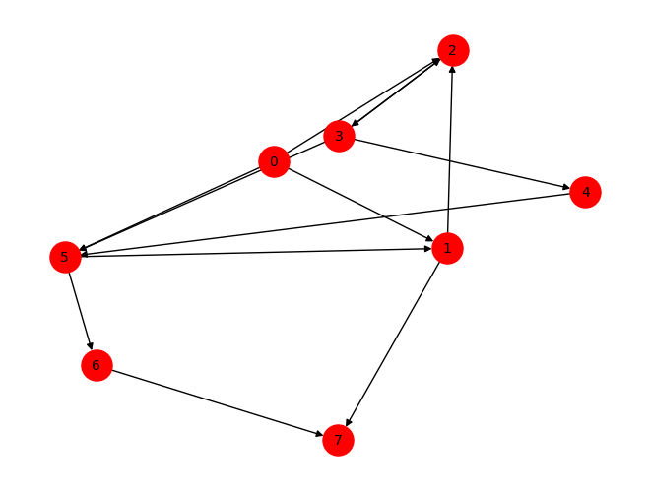
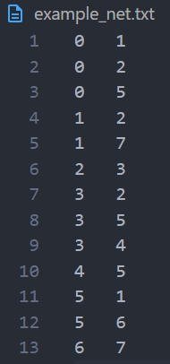
Adleman experiment
Provide a tab-delimited linked list (node label starting at 0)

Slide 12

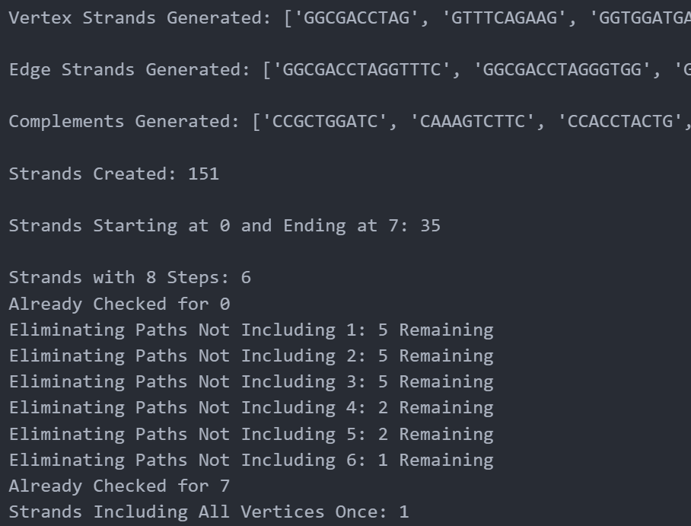
Adleman experiment
Provide a tab-delimited linked list (node label starting at 0)
Run the Adleman experiment simulation
Encode each node with a random string of bases k-bases long (k=10, arb.)
1
Encode edges with the last 5 bases of the vertex at the start of the edge, and the first 5 of the end of the edge
2
Generate random paths
3
Remove paths without correct start & end node
4
Keep only paths with n-vertices
5
Keep only paths with that touch each vertex at least once
6

Slide 13
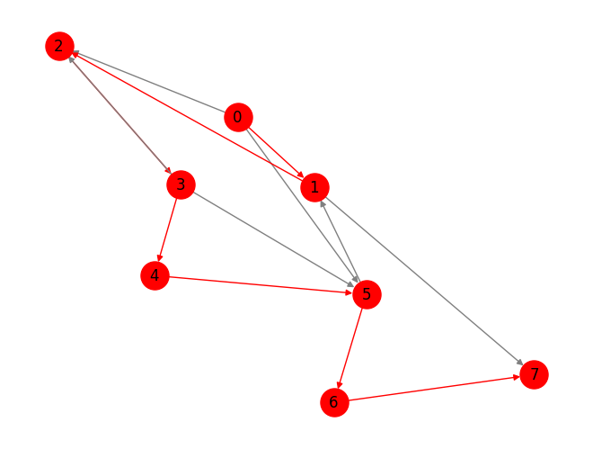
Adleman experiment
Provide a tab-delimited linked list (node label starting at 0)
Run the Adleman experiment simulation
Encode each node with a random string of bases k-bases long (k=10, arb.)
1
Encode edges with the last 5 bases of the vertex at the start of the edge, and the first 5 of the end of the edge
2
Generate random paths
3
Remove paths without correct start & end node
4
Keep only paths with n-vertices
5
Keep only paths with that touch each vertex at least once
6

Slide 14
Thank you!
AYDIN WELLS
CSE40/60932 – Exotic Computing
13/19/2024
https://github.com/Aywells/Exotic-Computing-Project

